Slide 1
Computer Vision: Looking Back to Look Forward
image source
Svetlana Lazebnik
IRIM Short Course
Spring 2020

Slide 2
Outline of lectures
Tues. 1/28: Where are we going, where have we been?
Wed. 1/29: Stepping back: What is the nature of visual perception?
Thurs. 1/30: History of ideas in recognition – Part I
Tues. 2/4: History of ideas in recognition – Part II – TSRB banquet hall
Wed. 2/5: Emerging trends – or, what should we be working on?
Thurs. 2/6: Ethical issues for computer vision researchers

Slide 3
The Three Philosophers: Marr, Gibson, Koenderink
Giorgione, The Three Philosophers, c. 1505

Slide 4
The Three Philosophers: Marr, Gibson, Koenderink
David Marr (1945-1980)
James Jerome Gibson (1904-1979)
Jan Johan Koenderink (b. 1943)

Slide 5
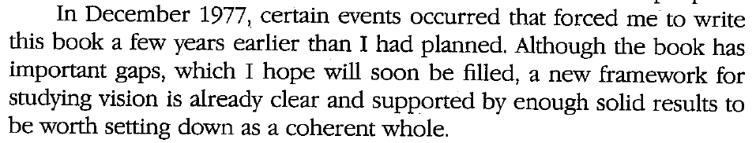
David Marr (1945-1980)
Ph.D. in theoretical neuroscience, Cambridge, 1969
Models of the cerebellum (1969), neocortex (1970), hippocampus (1971)
Joined MIT AI Lab in 1973, became professor of psychology in 1977
Stereo algorithms (with Tommaso Poggio), 1976-79
3D object representation (with Keith Nishihara), 1978
Edge detection (with Ellen Hildreth), 1980
Posthumous book: Vision (1982)
Bio
Full text

Slide 6
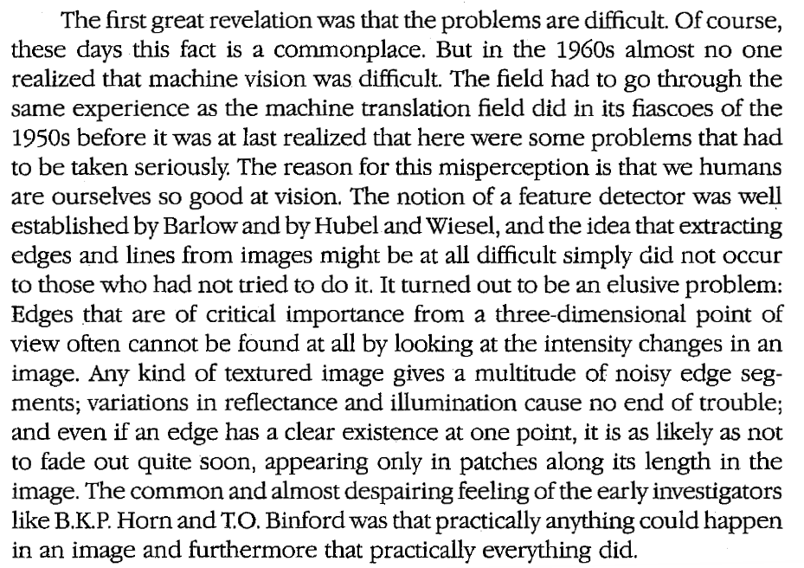
Marr’s motivation (ch. 1)
Vision is hard

Slide 7
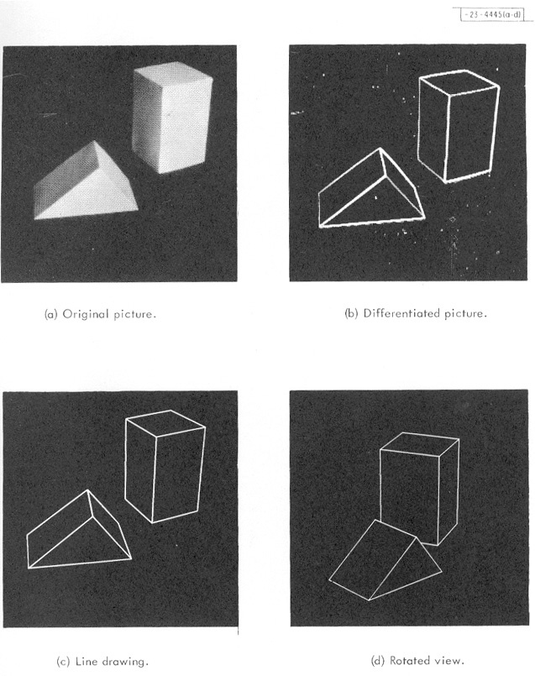
Marr’s motivation (ch. 1)
Vision is hard
We may not be able to figure out the right solution right away, but at least we should start by establishing a sound methodology
Marr explicitly considered and rejected low-level neurophysiology, empirical “hacking”, and blocks world simplification
Hubel & Wiesel (1959)
Roberts (1963)
(source)
Yakimovsky & Feldman (1973)

Slide 8
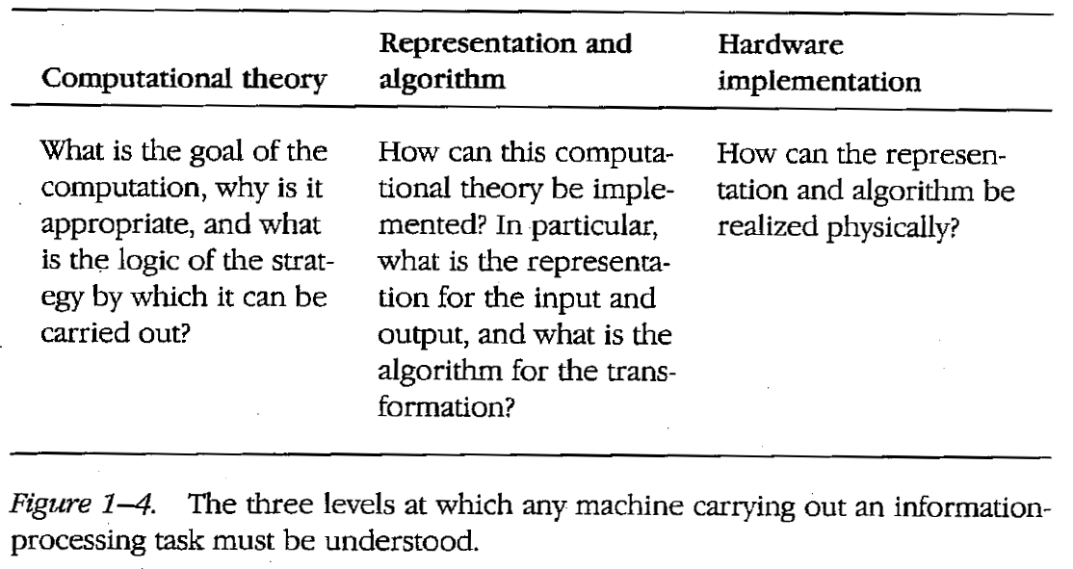
Towards an information processing theory of vision

Slide 9
Computational theory description of vision
What should be the goal of vision?
“Vision is a process that produces from images of the external world a description that is useful to the viewer and not cluttered with irrelevant information.”
What should be the input?
“In the case of human vision, the initial representation is in no doubt – it consists of arrays of image intensity values as detected by the photoreceptors in the retina.”
What should be the output?
”[The purpose of vision is] building a description of the shapes and positions of things from images… It also tells about the illumination and about the reflectances of the surfaces that make the shapes – their brightnesses and colors and visual textures – and about their motion. But these things seemed secondary; they could be hung off a theory in which the main job of vision was to derive a representation of shape.”

Slide 10
Proposed algorithmic pipeline
Image source
Notes:
Bottom-up, feedforward, modular

Slide 11
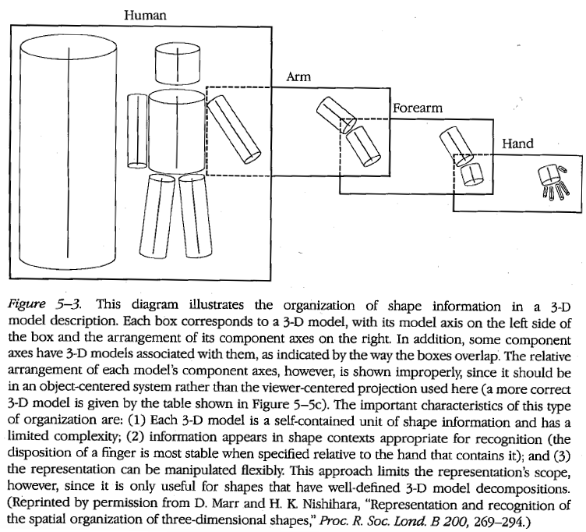
Close-up of proposed 3D representation

Slide 12
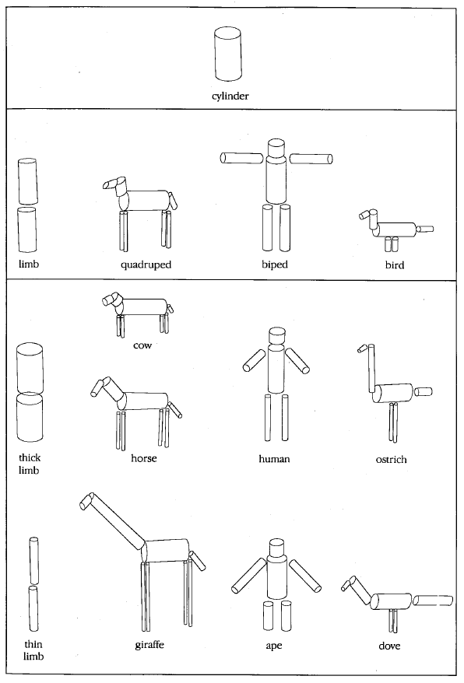
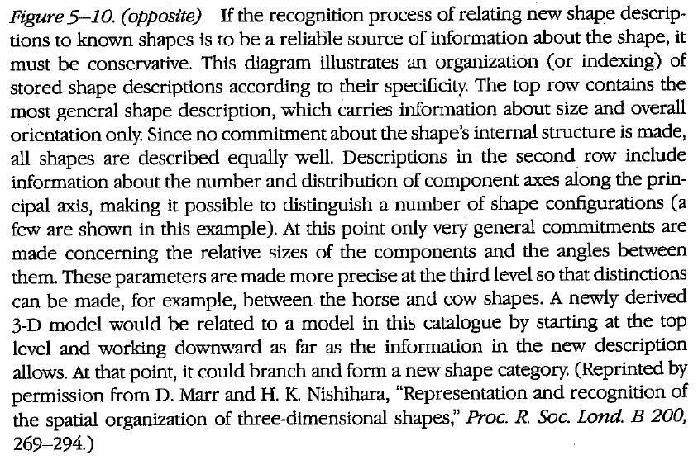
Close-up of proposed 3D representation

Slide 13
So, what’s the big deal?
Marr’s book was a major milestone
Critical summary of key developments in study of human and computer vision to date
Unprecedented attempt at a unified account of the entire visual system
Computational framework was very appealing to computer vision researchers from a “software engineering” perspective
Abstraction, modularity, feedforward pipeline
Theories meshed well with the dominant computer vision paradigms
Vision as “inverse graphics” or “inverse optics”
Emphasis on recovery of general-purpose 3D representations composed of simple geometric primitives
Convenient division of vision problems into “low-level”, “mid-level”, and “high-level”
Special issue dedicated to Marr: Perception 41(9), 2012

Slide 14
What about the bad stuff?
None of the particulars of Marr’s approach have panned out either on the human or the computer vision side
Principles of modularity and feedforward processing don’t hold for human vision
P. Churchland, V.S. Ramachandran, and T. Sejnowski, A critique of pure vision, 1994
Humans do not recover veridical, task-independent 3D representations
W. Warren, Does This Computational Theory Solve the Right Problem? Marr, Gibson, and the Goal of Vision, Perception 41(9), 2012
Marr dismissed statistical approaches, did not even consider learning
Even the goals, inputs, and outputs of a vision system are very much open to question (as discussed next)

Slide 15
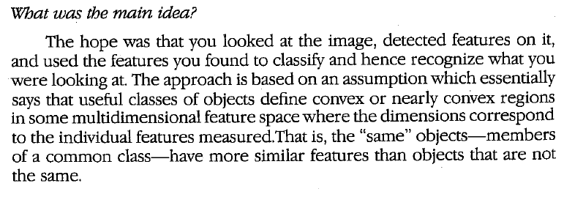
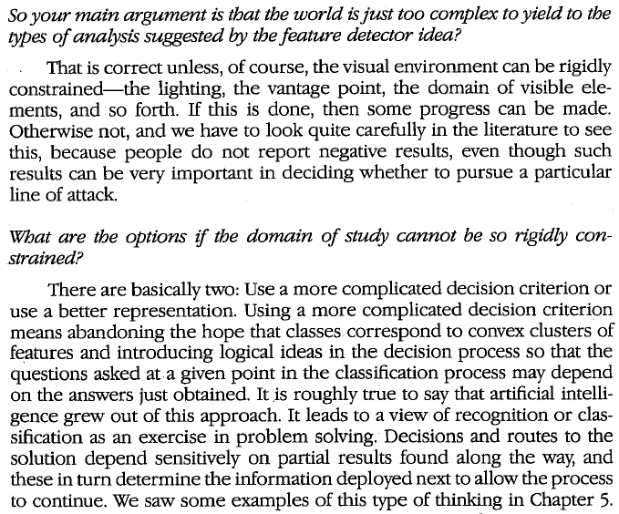
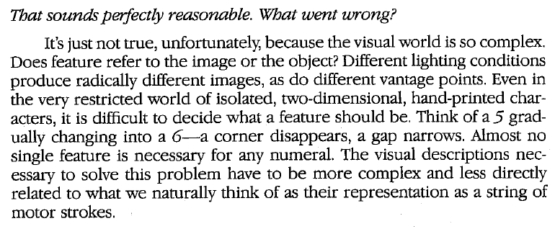
Marr’s rejection of “features” (ch. 7)

Slide 16
James Jerome Gibson (1904-1979)
Ph.D. in psychology, Princeton, 1928
Taught at Smith college, served in the Aviation Psychology Program during WWII, then taught at Cornell
Books:
The Perception of the Visual World (1950)
The Sense Considered as Perceptual Systems (1966)
The Ecological Approach to Visual Perception (1979)
Bio

Slide 17
The Gibson doctrine: My attempt at a summary
(Based on The Ecological Approach to Visual Perception, 1979)
Perception must be studied in the context of an organism’s environment and biological function
“To perceive is to be aware of the surfaces of the environment and oneself in it… The full awareness of surfaces includes their layout, their substances, their events, and their affordances.”
Perception is embodied and active, its key goal is control of behavior
To understand perception, one must use ecological physics (optics, geometry, etc.), i.e., concepts for understanding the environments of animals and people that are relevant for behavior
E.g., absolute space and time are ecologically meaningless

Slide 18
What is the input to perception?
It is not the retinal image!
Gibson regards “retinal image” as a harmful fiction. This image (if it even exists) changes constantly, whereas our awareness of the visual world is stable and unchanging
Instead, perception starts with the ambient optic array at a point of observation
“To be an array means to have an arrangement, and to be ambient at a point means to surround a position in the environment that could be occupied by an observer.”
The ambient optic array is structured into nested components corresponding to distinct parts of the environment (roughly speaking, “objects”)

Slide 19
The Gibson doctrine (cont.)
Percetion starts not with the “retinal image”, but with the ambient optic array
Perception happens by direct information pickup, or “the concurrent registering of both persistence and change in the flow of structured stimulation”
“Direct” means not mediated by information processing or internal representations: “The perceptual system simply extracts the invariants from the flowing array; it resonates to the invariant structure or is attuned to it”
For an active observer, perception is mostly unambiguous
Gibson views the case of “monocular arrested vision” as “unnatural” and dismisses illusions that arise from it

Slide 20
Affordances
The goal of perception is providing the agent with information relevant for control of behavior, encapsulated in affordances
“The affordances of the environment are what it offers the animal, what it provides or furnishes, either for good or ill. The verb to afford is found in the dictionary, but the noun affordance is not. I have made it up.”
Affordances are intrinsic invariants that can be had by any feature of the environment (place, object, surface, substance, or event)
“A fire affords warmth on a cold night; it also affords being burnt. An approaching object affords either contact without collision or contact with collision; a tossed apple is one thing, but a missile is another. For one of our early ancestors, an approaching rabbit afforded eating whereas an approaching tiger afforded being eaten.”

Slide 21
Perception of affordances vs. categorization
“The perceiving of an affordance is not a process of perceiving a value-free physical object to which meaning is somehow added in a way that no one has been able to agree upon; it is a process of perceiving a value-rich ecological object.”
“The theory of affordances rescues us from the philosophical muddle of assuming fixed classes of objects, each defined by its common features and then given a name… You do not have to classify and label things in order to perceive what they afford.”
Notes:
“As Ludwig Wittgenstein knew, you cannot specify the necessary and sufficient features of the class of things to which a name is given. They have only a ‘family resemblance.’ But this does not mean you cannot learn how to use things and perceive their uses.”

Slide 22
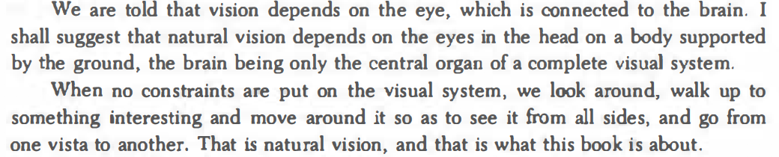
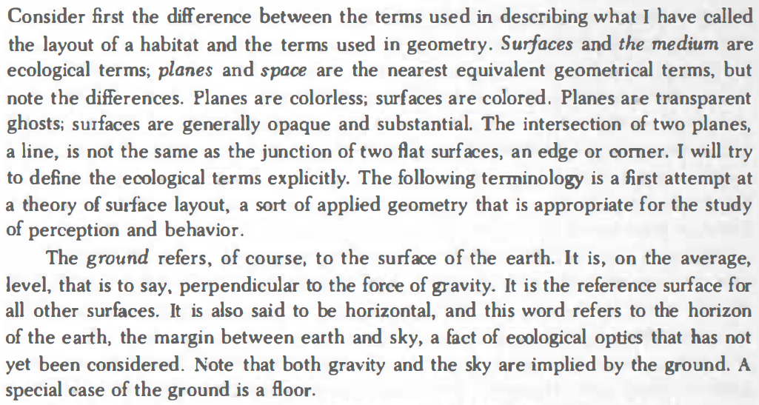
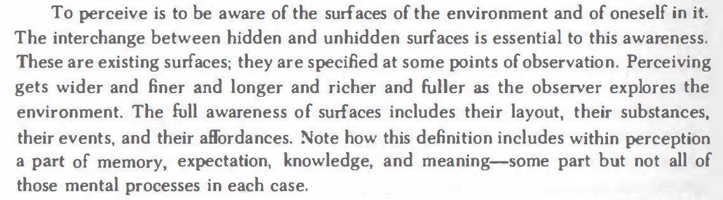
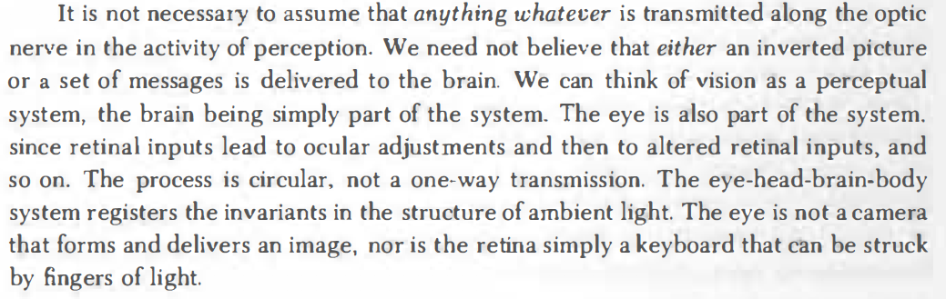
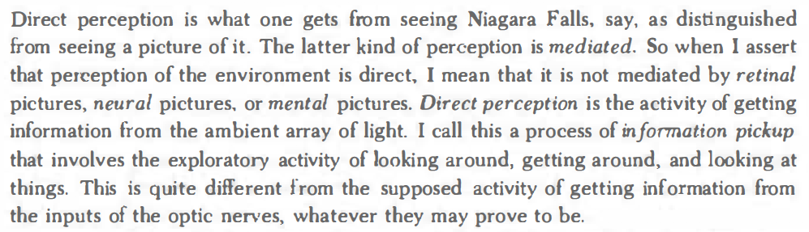
Gibson quotes

Slide 23
Gibson: What’s the big deal?
Emphasized the role of an active, embodied observer, and aspects of environment relevant for behavior
Warned of limitations of “snapshot vision”
Attached primary importance to motion and control
Pointed out that recovery of persistence and change, or world and observer, are two sides of the same coin
Direct perception is not a completely crazy idea: In many cases, cues relevant for action can indeed be perceived without going through a full general-purpose visual pipeline
Concept of affordances proved very influential

Slide 24
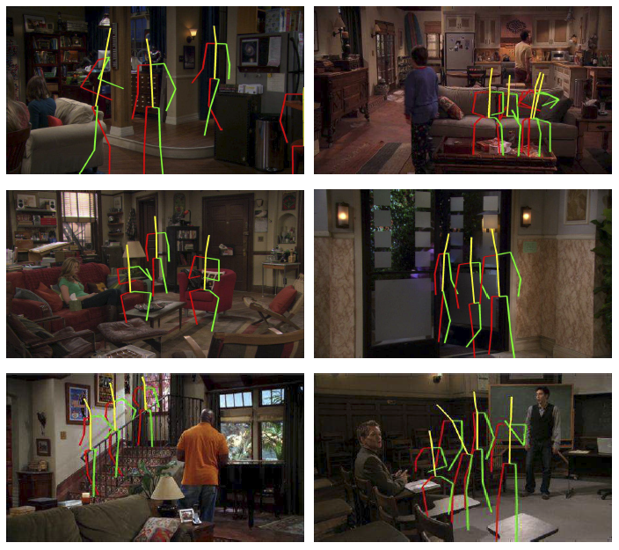
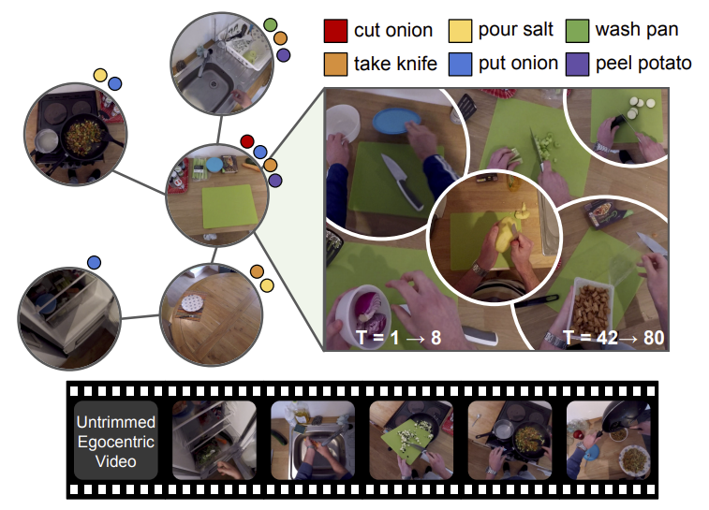
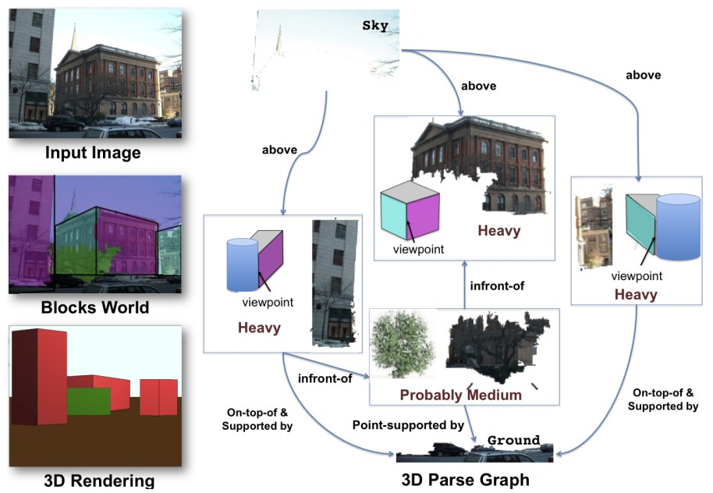
Gibson’s legacy
Concepts of affordances and “intuitive physics” have been inspirational or “aspirational” for computer vision researchers
Gupta et al. (2010)
Wang et al. (2017)
Nagarajan et al. (2019)

Slide 25
Gibson’s legacy
Same with his ideas about active perception and control
S. Soatto, Actionable information in vision, 2010
F. Xia et al., Gibson Env: Real-World Perception for Embodied Agents, CVPR 2018
“We must perceive in order to move, but we must also move in order to perceive” – J. J. Gibson

Slide 26
What about the bad stuff?
Gibson completely rejected questions of representation and information processing
According to Marr, Gibson was “misled by the apparent simplicity of the act of seeing” and seriously underestimated the complexity of extracting invariants
Viewed perception as primarily a function of the environment and downplayed the role of the observer
Paid only cursory lip service to learning
Notes:
Marr on Gibson: “In perception, perhaps the nearest anyone came to the level of computational theory was Gibson. However, although some aspects of his thinking were on the right lines, he did not understand properly what information processing was, which led him to seriously underestimate the complexity of the information processing problems involved in vision and the consequent subtlety that is necessary in approaching them… Gibson correctly regarded the problem of perception as that of recovering from sensory information that of ‘valid’ properties of the external world. His problem was that he had a much oversimplified view of how this should be done.”

Slide 27
Jan Johan Koenderink (b. 1943)
Ph.D. 1972, Utrecht University
Professor of physics and astronomy at Utrecht University, 1978-2008
Contributions (many with Andrea van Doorn)
Motion and optical flow (1975, 1976)
Stereopsis (1976)
Aspect graphs (1976, 1979)
Scale space theory (1984)
Properties of smooth 3D shapes and 2D contours (1982, 1984, 1992)
Affine structure from motion (1991)
Local grayvalue invariants (1987, 1994)
3D shape perception (1992, 1993, 1996)
Surface reflectance (1983, 1998, 1999)
Perception and art (2015)
Bio
Andrea van Doorn

Slide 28
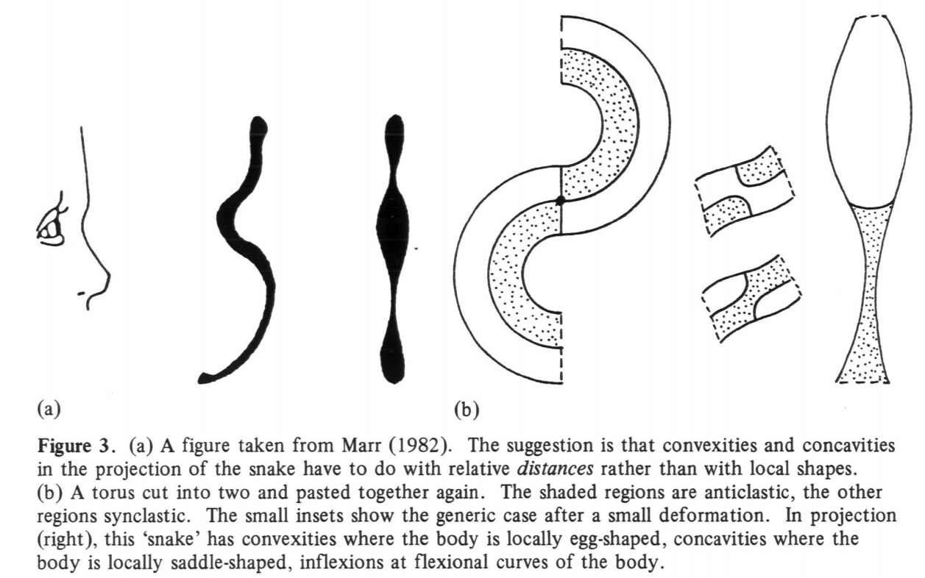
2D contour and 3D shape
J. Koenderink. What does the occluding contour tell us about solid shape? Perception 13 (321-330), 1984
Notes:
From F&P (ch. 13):
In 1977, Marr argued that the silhouette does not, in
general, tell us anything else about shape, claiming for example that the inflections
of a snake’s contour, that separate its convex parts from its concave ones (see the
next section for a formal definition), in general have nothing to do with the intrinsic
local surface shape, but correspond instead to the boundaries between far and
near parts of the snake’s body, the near regions appearing larger than the far ones
due to perspective effects (Figure 13.2, left). Although intuitively plausible, this
interpretation is incorrect. Indeed, as shown by Koenderink in a delightful 1984
article, the inflections of the contour are the projections of parabolic surface points
that separate convex parts of the surface from saddle-shaped, or hyperbolic ones
(Figure 13.2, right; we will prove a quantitative version of this result later in this
chapter). Thus, they indeed always reveal something of the intrinsic shape of the
observed object.
Koenderink’s view is that of a physicist trying to understand and model the
laws that govern the visual world, and it prevails in this chapter, where the accent
is not on applications but on a theoretical understanding of what can, or cannot
be said about the world by merely looking at it.

Slide 29
2D contour and 3D shape
J. Koenderink. What does the occluding contour tell us about solid shape? Perception 13 (321-330), 1984
Notes:
From F&P (ch. 13):
In 1977, Marr argued that the silhouette does not, in
general, tell us anything else about shape, claiming for example that the inflections
of a snake’s contour, that separate its convex parts from its concave ones (see the
next section for a formal definition), in general have nothing to do with the intrinsic
local surface shape, but correspond instead to the boundaries between far and
near parts of the snake’s body, the near regions appearing larger than the far ones
due to perspective effects (Figure 13.2, left). Although intuitively plausible, this
interpretation is incorrect. Indeed, as shown by Koenderink in a delightful 1984
article, the inflections of the contour are the projections of parabolic surface points
that separate convex parts of the surface from saddle-shaped, or hyperbolic ones
(Figure 13.2, right; we will prove a quantitative version of this result later in this
chapter). Thus, they indeed always reveal something of the intrinsic shape of the
observed object.
Koenderink’s view is that of a physicist trying to understand and model the
laws that govern the visual world, and it prevails in this chapter, where the accent
is not on applications but on a theoretical understanding of what can, or cannot
be said about the world by merely looking at it.

Slide 30
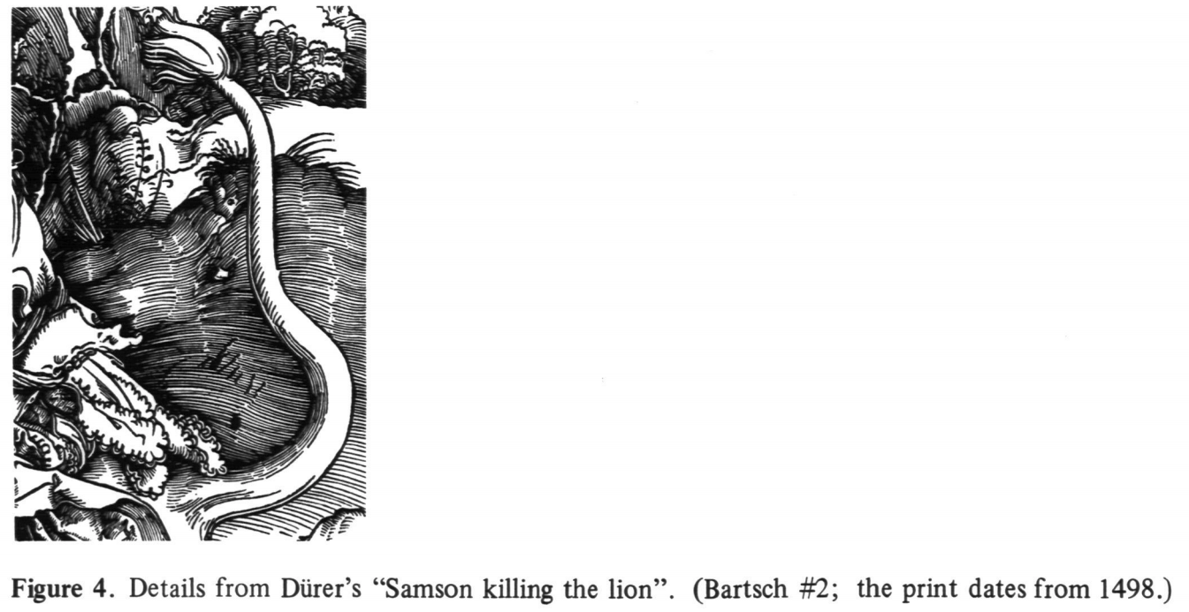
2D contour and 3D shape
J. Koenderink. What does the occluding contour tell us about solid shape? Perception 13 (321-330), 1984
Notes:
From F&P (ch. 13):
In 1977, Marr argued that the silhouette does not, in
general, tell us anything else about shape, claiming for example that the inflections
of a snake’s contour, that separate its convex parts from its concave ones (see the
next section for a formal definition), in general have nothing to do with the intrinsic
local surface shape, but correspond instead to the boundaries between far and
near parts of the snake’s body, the near regions appearing larger than the far ones
due to perspective effects (Figure 13.2, left). Although intuitively plausible, this
interpretation is incorrect. Indeed, as shown by Koenderink in a delightful 1984
article, the inflections of the contour are the projections of parabolic surface points
that separate convex parts of the surface from saddle-shaped, or hyperbolic ones
(Figure 13.2, right; we will prove a quantitative version of this result later in this
chapter). Thus, they indeed always reveal something of the intrinsic shape of the
observed object.
Koenderink’s view is that of a physicist trying to understand and model the
laws that govern the visual world, and it prevails in this chapter, where the accent
is not on applications but on a theoretical understanding of what can, or cannot
be said about the world by merely looking at it.

Slide 31
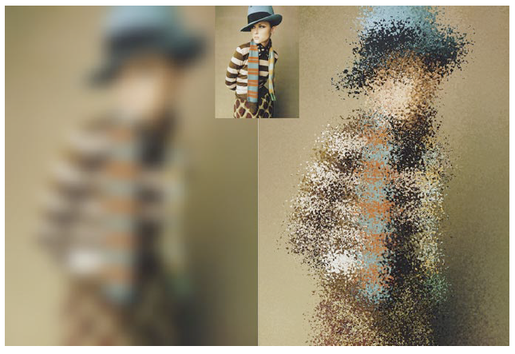
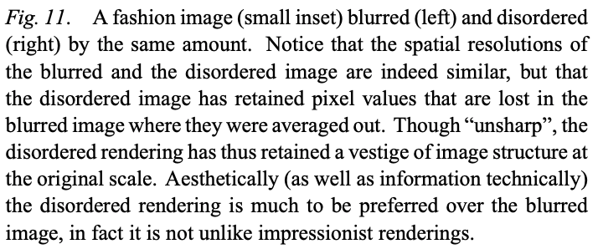
Locally orderless images
J. Koenderink and A. van Doorn, The structure of locally orderless images, IJCV 31 (159-168), 1999
Notes:
Abstract. We propose a representation of images in which a global, but not a local topology is defined. The topology is restricted to resolutions up to the extent of the local region of interest (ROI). Although the ROI’s may contain many pixels, there is no spatial order on the pixels within the ROI, the only information preserved is the histogram of pixel values within the ROI’s. This can be considered as an extreme case of a textel (texture element) image: The histogram is the limit of texture where the spatial order has been completely disregarded. We argue that locally orderless images are ubiquitous in perception and the visual arts. Formally, the orderless images are most aptly described by three mutually intertwined scale spaces. The scale parameters correspond to the pixellation (“inner scale”), the extent of the ROI’s (“outer scale”) and the resolution in the histogram (“tonal scale”). We describe how to construct locally orderless images, how to render them, and how to use them in a variety of local and global image processing operations.

Slide 32
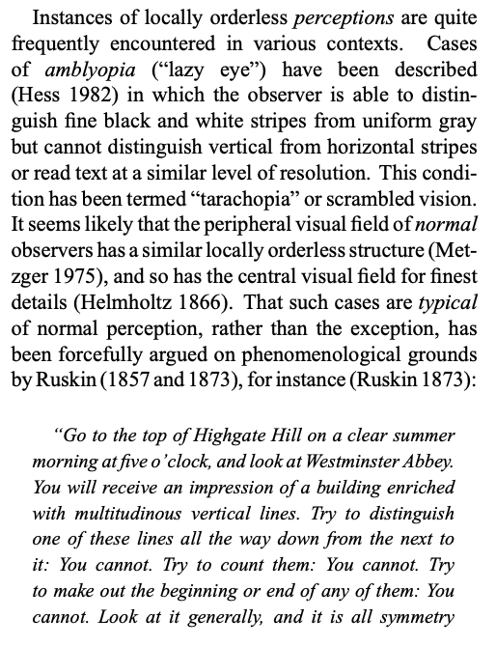
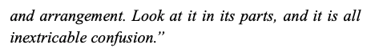
Locally orderless images
J. Koenderink and A. van Doorn, The structure of locally orderless images, IJCV 31 (159-168), 1999

Slide 33
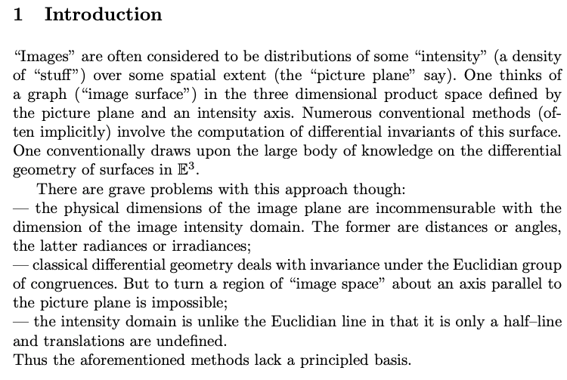
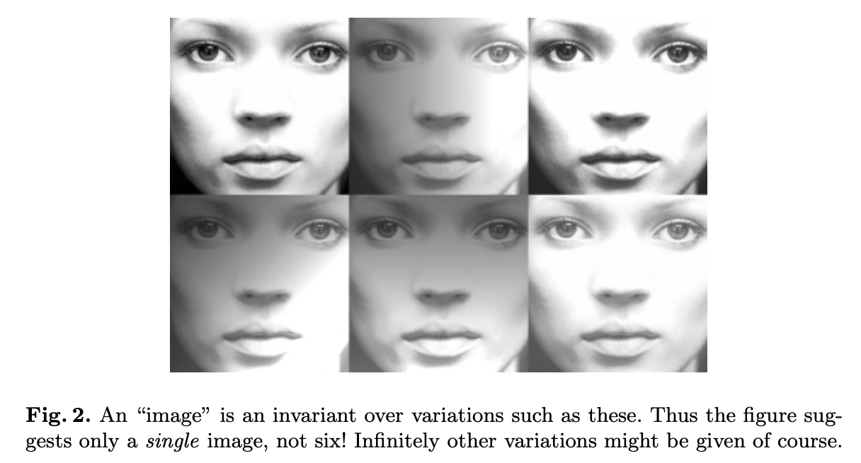
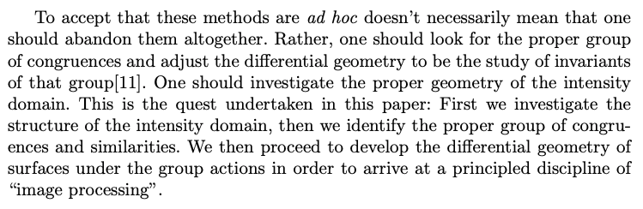
Image processing done right
J. Koenderink and A. van Doorn, Image processing done right, ECCV 2002

Slide 34
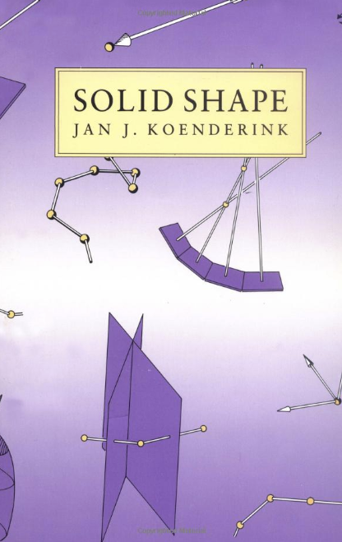
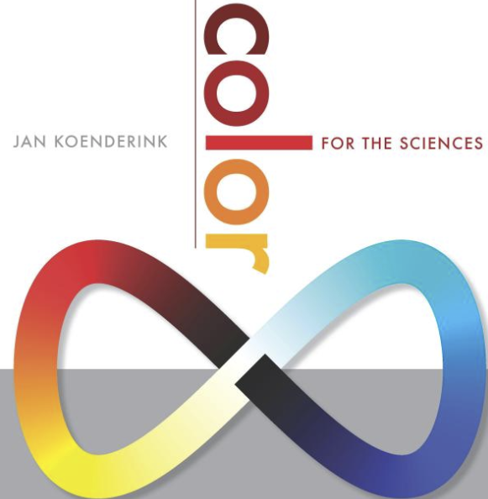
Books
1991
2010
See also: E-Books

Slide 35
Koenderink: What’s the big deal?
Style of work is that of a mathematical theorist of perception, starting with some visual phenomenon and creating an elegant mathematical formalization to describe it
Some of these formalizations have been quite influential and even useful when translated into more accessible terms and suitably operationalized
Research is guided by a strong sense of taste and aesthetics

Slide 36

A grand theory of perception?
J. Koenderink, Sentience, 2019

Slide 37
A grand theory of perception?
Heavily influenced by Jakob von Uexküll
German biologist, 1864-1944
J. Koenderink, Sentience, 2019

Slide 38
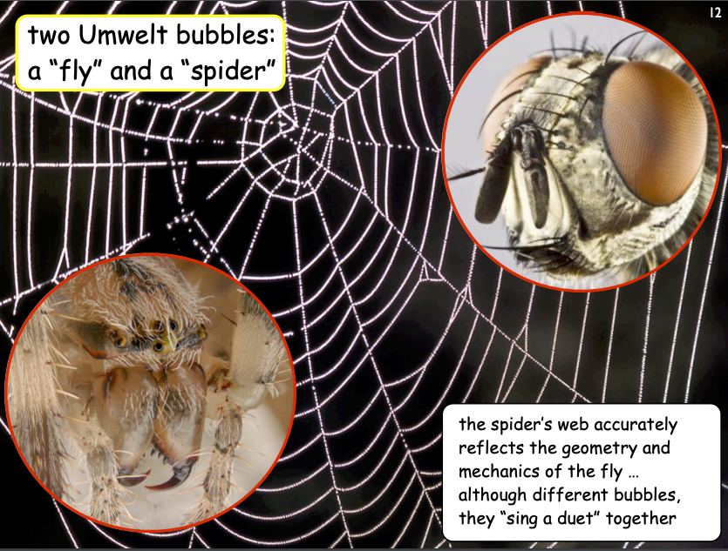
Sensory-action worlds
Each organism has its own umwelt or “surrounding world”
This is the organism’s sensory and action world. It is determined by biology “bounds the universe from the perspective of the animal”
J. Koenderink, Sentience, 2019
Source: Koenderink's slides

Slide 39
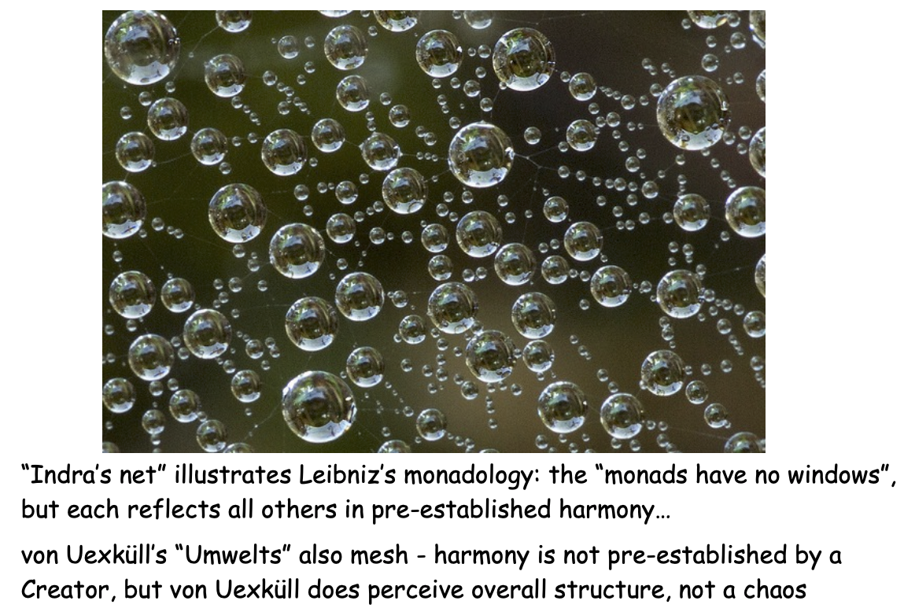
Sensory-action worlds
Each organism has its own umwelt or “surrounding world”
This is the organism’s sensory and action world. It is determined by biology “bounds the universe from the perspective of the animal”
J. Koenderink, Sentience, 2019
Source: Koenderink's slides

Slide 40
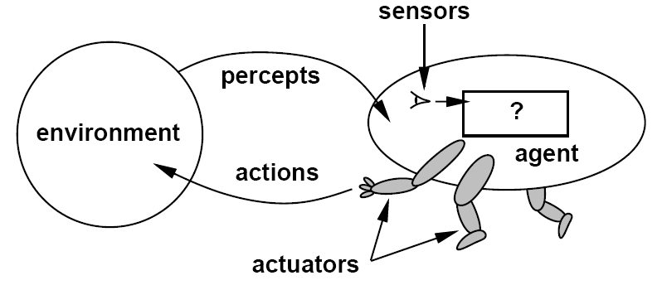
The AI viewpoint
Figure from Russell & Norvig

Slide 41
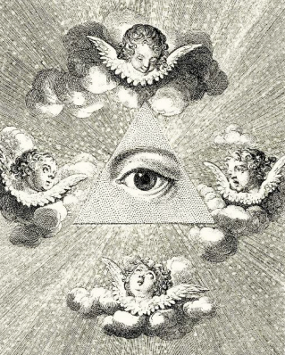
Sensory-action worlds
Each organism has its own umwelt or “surrounding world”
This is the organism’s sensory and action world. It is determined by biology “bounds the universe from the perspective of the animal”
Absolute time and space don’t exist from the organism’s point of view
Gibson had a similar idea, but he still implicitly assumed a “God’s eye” view that Koenderink rules out
J. Koenderink, Sentience, 2019

Slide 42
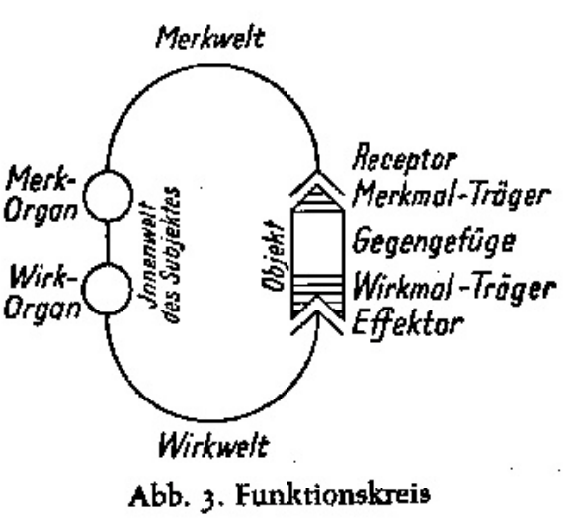
Perception-action cycles
Figures from von Uexküll’s Theoretische Biologie, 1920

Slide 43
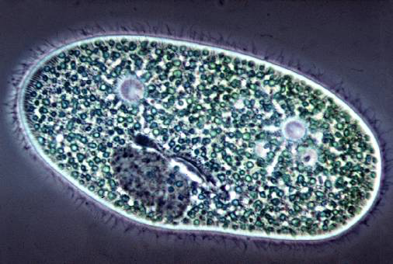
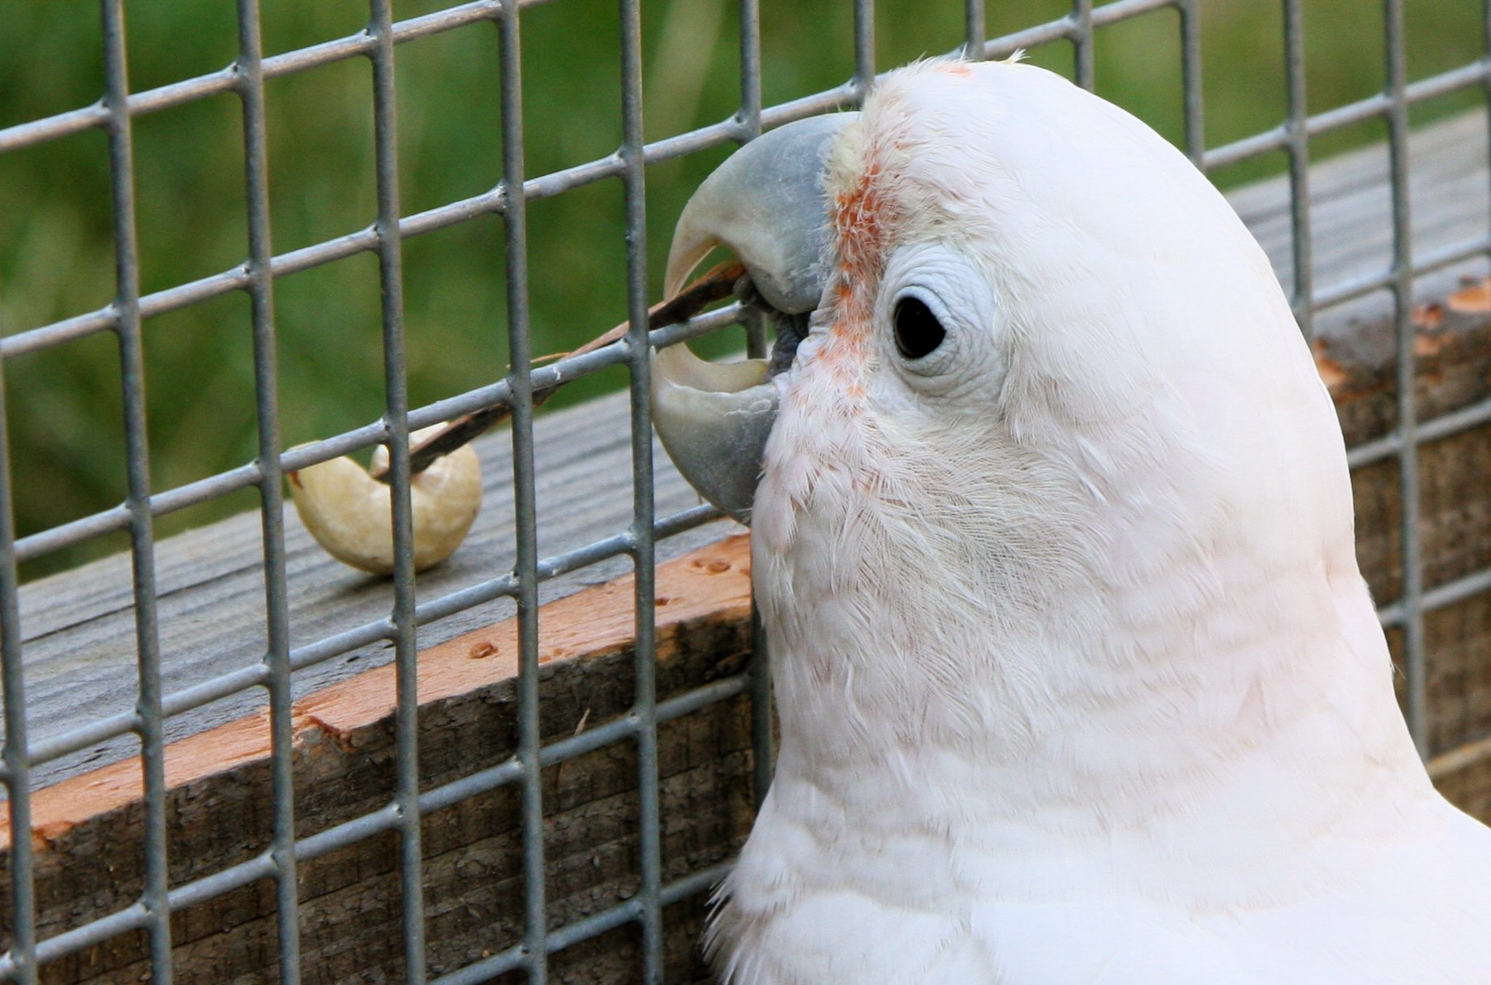
The AI viewpoint
Reflex agent
Predictive agent
Consider how the world IS
Choose action based only on current percept
Do not consider the future consequences of actions
Consider how the world WOULD BE
Decisions based on (hypothesized) consequences of actions
Must have a model of how the world evolves in response to actions
Sources: D. Klein, P. Abbeel, my AI slides

Slide 44
Sensorimotor feedback loop
Input from the world
Feedback about the action
“Inner world” of the agent or interface between the agent and the world
The world itself no longer matters!
Action to affect the world
J. Koenderink, Sentience, 2019
Figure from von Uexküll’s Theoretische Biologie, 1920
Notes:
- The sensors receive input from the environment and it somehow gets transformed into an action to affect the environment
- Information about the action feeds back to the sensors allowing the organism to predict the effect of its actions on the environment. If the prediction is completely correct, nothing interesting is happening.
- Without such feedback, an organism is a simple reflex agent that cannot be said to be aware of the world
- This “new loop” creates a complete interface between the organism and the world. The organism does not experience the world in any other way except through this interface
Per Koenderink, the origins of the organism’s “sentience” or “awareness” lie within this loop (in particular, when its prediction is incorrect)
We can further speculate that an internal model of the world is required to carry out this loop. Crucially, this model has to be a predictive representation, which accords with trendy ideas in deep learning.
In turn, predictive models must have a close relationship to perception of invariance and change in the world (per Gibson)
Any complex organism contains hierarchies or “heterarchies” of loops that take their inputs from other loops and send their outputs to yet other loops
If you squint the right way, this sounds like deep learning architectures

Slide 45
Interface theory of perception
The “new loop” creates a complete interface between the organism and the world. The organism does not experience the world in any other way except through this interface
However, the world is still perceived as being “out there” and it can still kill us
D. Hoffman, The interface theory of perception, Object Categorization: Computer and Human Vision Perspectives, 2009
See also https://www.quantamagazine.org/the-evolutionary-argument-against-reality-20160421/

Slide 46
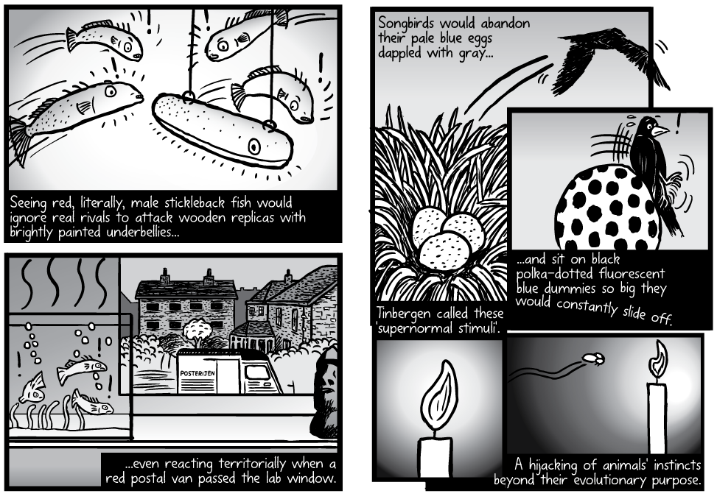
Non-veridicality of perception
Perception evolved not to produce “accurate” representations of the world, but to further organisms’ fitness
It is easy to “hack” many organisms with supernormal stimuli
Source
(Wikipedia)

Slide 47
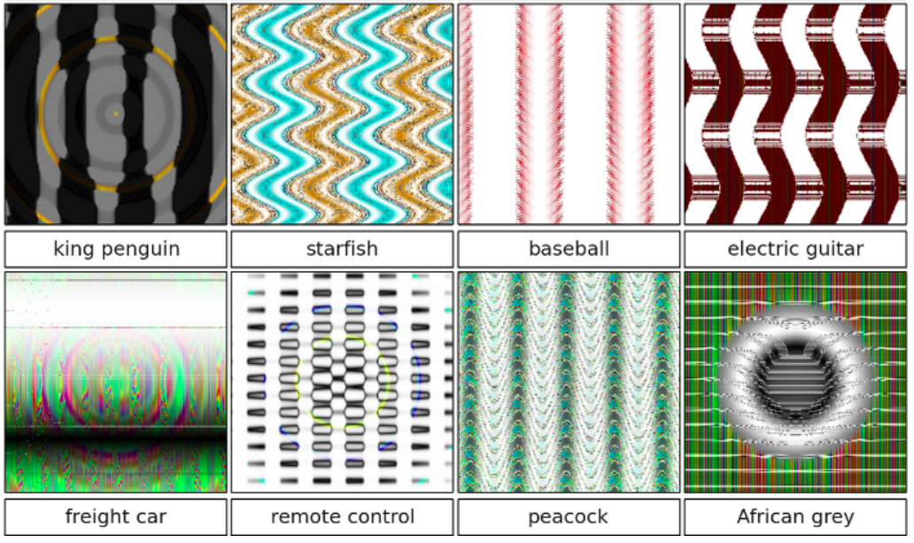
Non-veridicality of perception
Perception evolved not to produce “accurate” representations of the world, but to further organisms’ fitness
It is easy to “hack” many organisms with supernormal stimuli
Supernormal stimuli for neural networks?
A. Nguyen, J. Yosinski, J. Clune, Deep Neural Networks are Easily Fooled: High Confidence Predictions for Unrecognizable Images, CVPR 2015

Slide 48
Sensorimotor feedback loop
Input from the world
Feedback about the action
“Inner world” of the agent or interface between the agent and the world
The world itself no longer matters!
Action to affect the world
J. Koenderink, Sentience, 2019
Figure from von Uexküll’s Theoretische Biologie, 1920
Notes:
- The sensors receive input from the environment and it somehow gets transformed into an action to affect the environment
- Information about the action feeds back to the sensors allowing the organism to predict the effect of its actions on the environment. If the prediction is completely correct, nothing interesting is happening.
- Without such feedback, an organism is a simple reflex agent that cannot be said to be aware of the world
- This “new loop” creates a complete interface between the organism and the world. The organism does not experience the world in any other way except through this interface
Per Koenderink, the origins of the organism’s “sentience” or “awareness” lie within this loop (in particular, when its prediction is incorrect)
We can further speculate that an internal model of the world is required to carry out this loop. Crucially, this model has to be a predictive representation, which accords with trendy ideas in deep learning.
In turn, predictive models must have a close relationship to perception of invariance and change in the world (per Gibson)
Any complex organism contains hierarchies or “heterarchies” of loops that take their inputs from other loops and send their outputs to yet other loops
If you squint the right way, this sounds like deep learning architectures

Slide 49
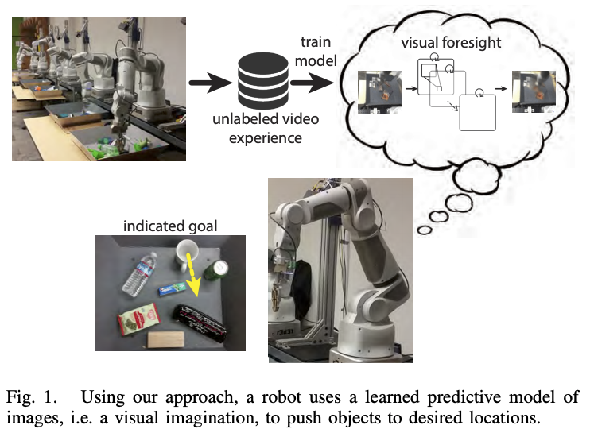
Link to today’s predictive models
C. Finn and S. Levine, Deep Visual Foresight for Planning Robot Motion, ICRA 2017

Slide 50
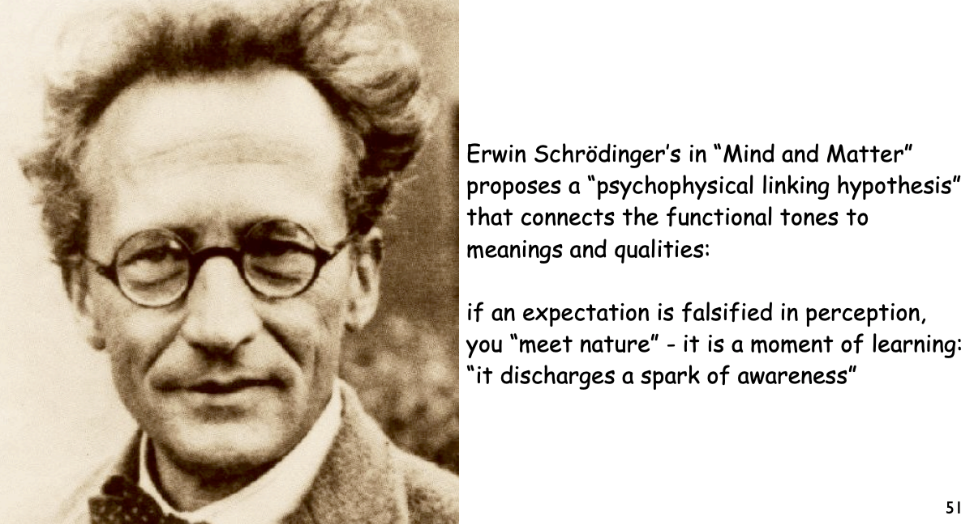
The awareness “hypothesis”
The “new loop” is the source of the organism’s sentience or awareness
In particular, discrepancies between the predictions of the feedback mechanism and the observed state of the world generate “sparks of awareness” (a view held by Erwin Schrödinger)
J. Koenderink, Sentience, 2019
Source: Koenderink's slides

Slide 51
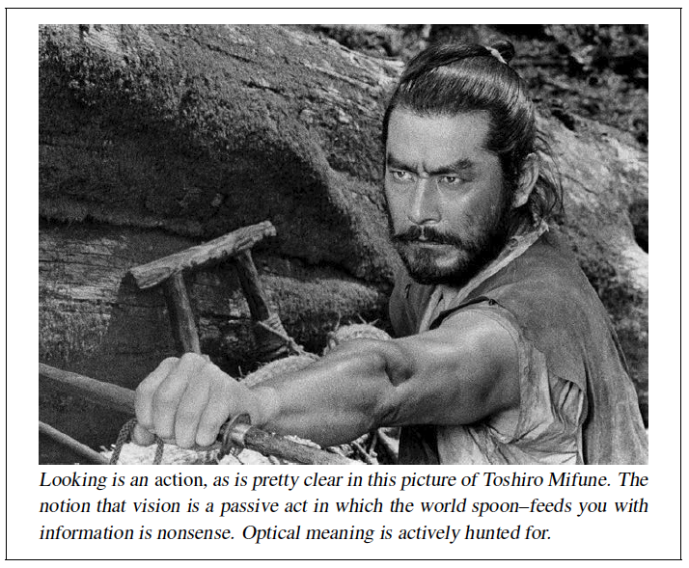
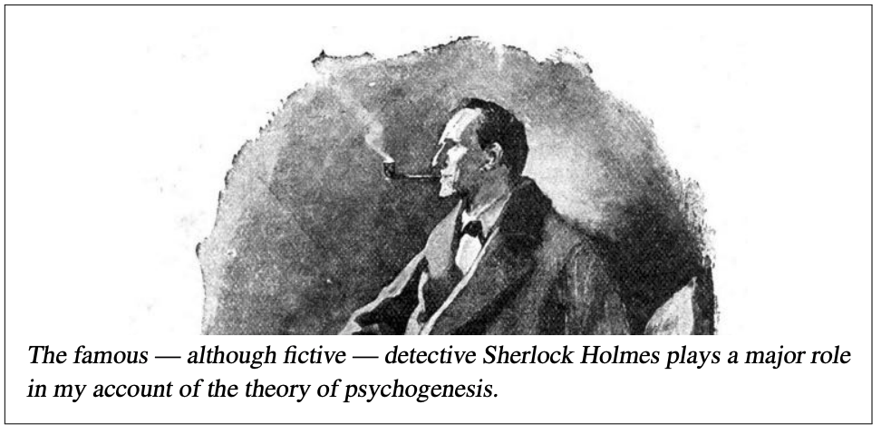
The process of perception
Perception is a fundamentally active, creative process that generates theories about the world based on sensory input and retains the theory that best fits the input
J. Koenderink, Sentience, 2019
Source: Koenderink's slides

Slide 52
The process of perception
Perception is a fundamentally active, creative process that generates theories about the world based on sensory input and retains the theory that best fits the input
Contrary to Marr, perception is most definitely not “inverse optics”
Contrary to Gibson, perception is not a function primarily of the environment. It can frequently be ambiguous and is heavily driven by the organism’s goals, desires, and internal state
J. Koenderink, Sentience, 2019

Slide 53
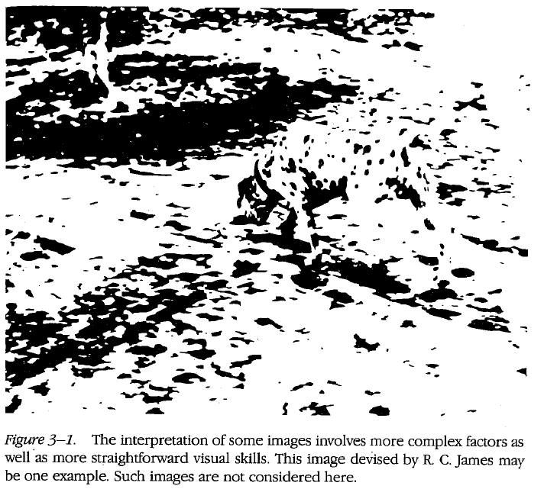
Implications
“Perceptual organization” cannot be primarily a bottom-up process as Marr saw it
Figure from Marr

Slide 54
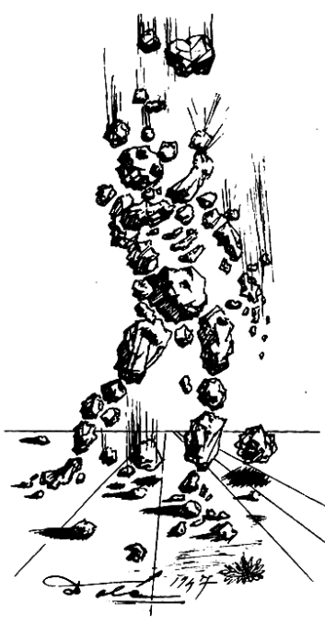
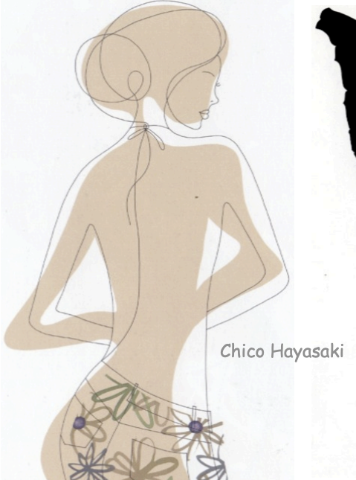

Implications
“Perceptual organization” cannot be primarily a bottom-up process as Marr saw it
Koenderink: “Edges are imposed, not detected”
S. Dali
My example: 10th & Peachtree

Slide 55
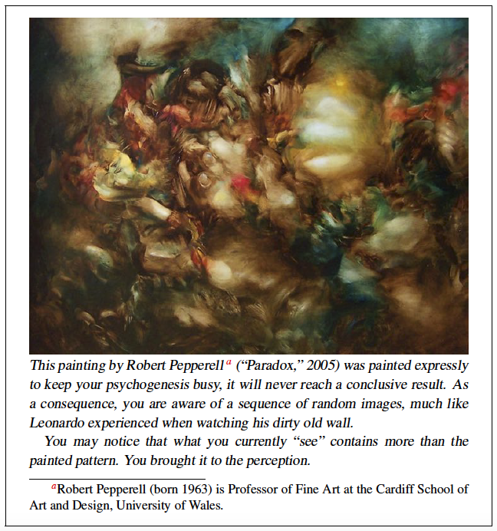
Implications
Could Koenderink’s speculations be applied to GANs?
See A. Hertzmann, Visual Indeterminacy in Neural Generative Art, 2019

Slide 56
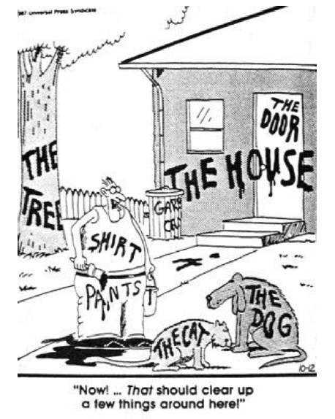
What about recognition?
Koenderink agrees with Gibson that “object categories” don’t make sense

Slide 57
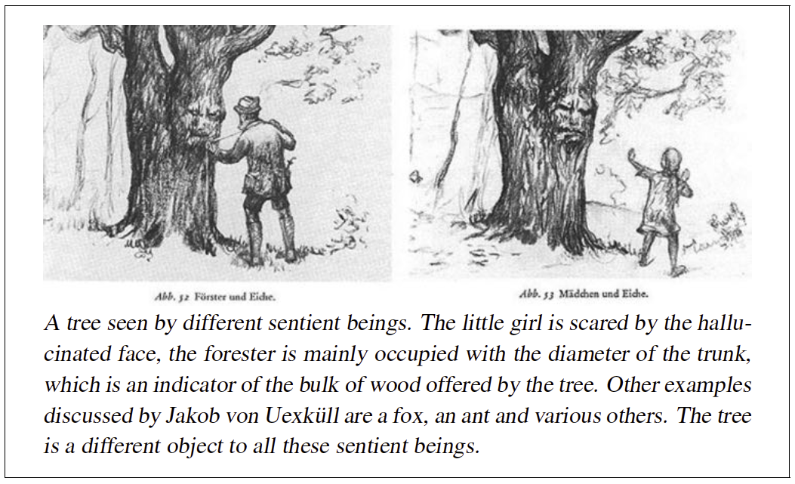
What about recognition?
Koenderink agrees with Gibson that “object categories” don’t make sense
J. Koenderink, Sentience, 2019

Slide 58
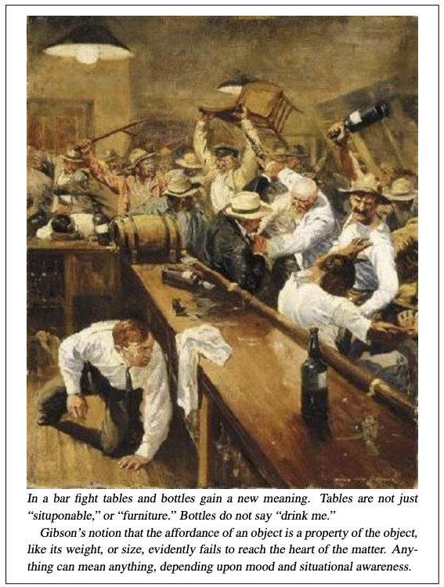
What about recognition?
At best, categories are “bundles of cues that play a role in actions”
Similar to Gibson’s affordances but to Koenderink, there is no such thing as an intrinsic affordance
J. Koenderink, Sentience, 2019

Slide 59
Summary
Marr, Gibson, and Koenderink all asked about the nature of vision and came up with different answers
“Vision is a computational process that transforms the retinal image into an objective representation of 3D shape.”
“There is no computation. There is no retinal image. There are no representations. There is no 3D shape. There is only direct pickup of ecologically relevant variants and invariants. Vision is in the world, not the observer.”
“There is no objective world, only the observer’s umwelt. Thus, vision cannot be in the world but is a creative act of the observer.”

Slide 60
Take-aways
The time may be right to take on the “crazier” ideas of Gibson and Koenderink
We need to study embodied vision
We need to build models with feedback
We need to focus on “ecologically meaningful” tasks (and object classification is most likely not it)
We need to integrate discriminative and generative models
To be picked up in Lecture 5…

